Slide 1

WALMART SUPERSTORE ANALYSIS USING POWER BI
CAPSTONE PROJECT BY : AKHILA R
BATCH CODE: MBE7
COURSE: ZEN BADM

Slide 2
INTRODUCTION
This project is about analyzing the Walmart superstore dataset and gathering powerful insights on sales, profit, customer demographics, etc, using power BI visualizations.
Walmart is one of the most successful American multinational retail corporation. It operates both offline and online with wide variety of products.
They are known for their everyday low-price strategy which makes them differentiated and successful.
Some of their main competitors are amazon and target.

Slide 3
PROJECT STRUCTURE
PROFIT FORECAST
SALES & REVENUE ANALYSIS
CUSTOMER SALES CONTRIBUTION 80:20 PARETO CHART
WALMART SUPERSTORE DATASET
CLEANING AND IMPORTING DATA
CUSTOMER ANALYSIS
DASHBOARDS CREATION
INVENTORY & STORE MANAGEMENT
ROOT CAUSE ANALYSIS

Slide 4
CLEANING AND IMPORTING DATA
Convert the csv file into excel workbook.
Check and correct the date data type.
Check for abnormal symbols like ¶, Ã, ¤ and replace or erase it.
Change discount column into percentage format.
Import the excel into Power BI

Slide 5
DATA EXPLORATION
S.NO | DATA TYPE | COLUMN NAMES
1 | INTEGER | Row ID (3203), Postal Code (180) ,Quantity (14)
2 | FLOAT/ DECIMAL | Sales (2348), Discount (5), Profit (2614)
3 | DATE | Order Date (845), Ship Date (911)
4 | TEXT | Order ID (1611), Ship Mode (4), Customer ID (686), Customer Name (686), Segment (3), Country (1), City (169), State (11), Region (1), Product ID (1509) , Category (3), Sub- Category (17), Product Name (1494)

Slide 6
DATA EXPLORATION
Row ID: contains an ID or serial number for each entry.
Order ID: contains two alphabets (CA/US) followed by the year of order and 6 numbers. These three elements are separated by a hyphen (-). Example: CA-2011-143336.
Order Date and Ship Date consists the dates of order and shipping of the order placed.
Ship Mode: indicates the shipping mode, and has four unique values
First Class: 1 to 3 days.
Same Day: same day or next day.
Second Class: 2 to 5 days.
Standard Class: 3 to 7 days.
Customer ID and Customer Name: Each customer has a unique ID, containing Two Alphabets with the first character of their first and second name followed by a 6-digit numeric value separated by a “-”. Example: RA-19885. There are 686 unique customers.
Segment: This indicates the three customer segments: Corporate, Consumer, Home Office
Category is divided into: Furniture, Office Supplies and Technology. There are total of 17 sub-categories
Product ID: Each product has first three letters of the category followed by first two letters of the sub category and an 8-digit numeric value separated by “-”. Example: OFF-BI-10002215.
Discounts are either 0%, 15%,20%,50%,70%.

Slide 7
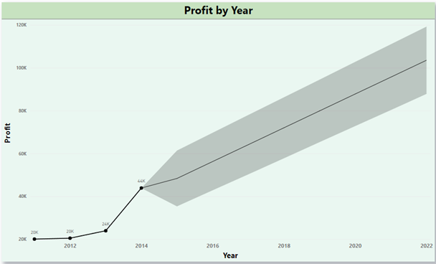
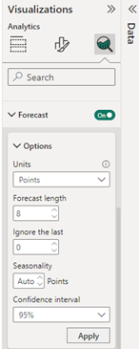
PROFIT FORECAST:
YEAR | PROFIT FORECAST | UPPER LIMIT | LOWER LIMIT
2011 | $20,065.69 | - | -
2012 | $20,492.19 | - | -
2013 | $23,959.94 | - | -
2014 | $43,900.63 | - | -
2015 | $48,368.64 | $61,403.50 | $35,333.77
2016 | $56,249.39 | $69,688.59 | $42,810.20
2017 | $64,130.15 | $77,964.96 | $50,295.34
2018 | $72,010.91 | $86,233.34 | $57,788.48
2019 | $79,891.67 | $94,494.38 | $65,288.95
2020 | $87,772.42 | $102,748.65 | $72,796.18
2021 | $95,653.18 | $110,996.67 | $80,309.67
2022 | $103,533.94 | $119,238.87 | $87,829.01

Slide 8
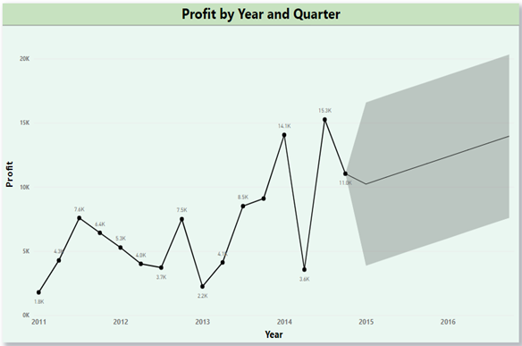
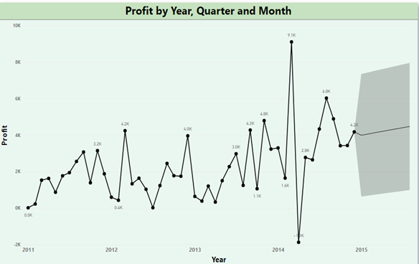
PROFIT FORECAST:
There is no pattern found in profit by year and quarter. However in 2011 and 2014 Quarter 3 had the highest profit and in 2012 and 2013 Quarter 4 had the highest profit.
March 2014 marked the highest profit of all months, having profit value of 9107.03.
April 2014 had loss of 1867.75

Slide 9
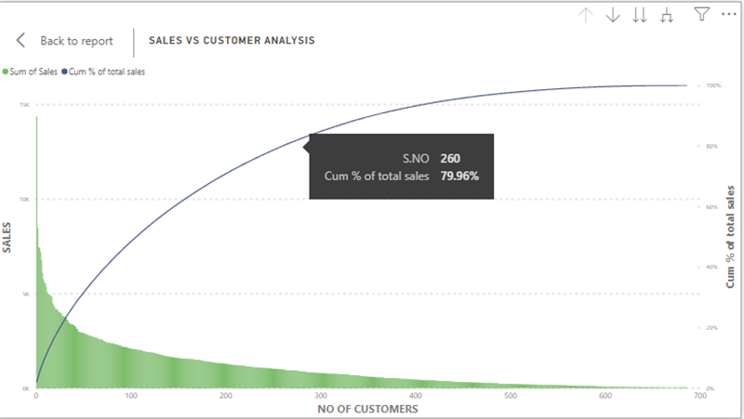
SALES & CUSTOMER RATIO ANALYSIS
To prove that 80% of sales is coming from 20% of customers we use a popular chart “Pareto Chart”. In order to visualise this chart, we need three values
1. No. of Customers in descending order of 1 to 686 with customer 1 having the highest sales value.
2. Sales from each customer in descending order.
3. Cumulative Sales percentage.
260 customers, i.e 37.9% of customers are contributing to 80% of sales.

Slide 10
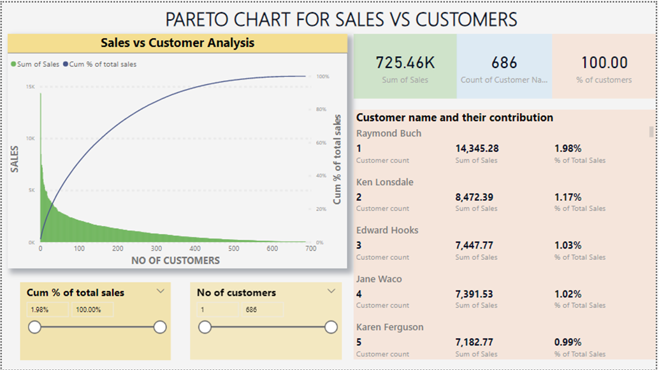
SALES & CUSTOMER RATIO ANALYSIS

Slide 11
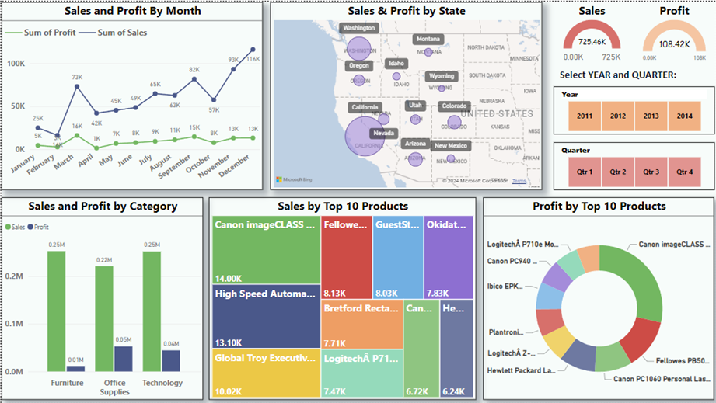
SALES AND REVENUE DASHBOARD
A Sales and Profit dashboard is created to track the store's sales and revenue over time, by category, region, and product.

Slide 12
SALES AND REVENUE DASHBOARD
There is a consistent rise in sales. Increased sales during : March, September, November and December.
The profit line is somewhat consistent in nature with peak in march.
Select years in filter: In all years December sales stands the highest of that year. This may be due to Christmas and New year discounts/offers.
A simple map with size bubbles of sales in each state shows California contributes to high sales and profit. The lowest sales is from Wyoming (one customer who has ordered chairs on 13th November 2013).
The states which generate loss: Colorado, Arizona, Oregon.
In Wyoming products are bought only from home office segment and in Montana there are customers who get products only from home office and consumer segment.
In order to sell all segments in all states, we need to increase the marketing for other categories but also focus on providing most purchased products with maximum customer satisfaction.
Sales and profit by product category shows that sales is same for all the categories (>0.2M), but profit is more from the category Office supplies and Technology.
Sales and profit by segment chart show that sales and profit are high in consumer segment.
Heat map:shows the top 10 products contributing to sales.
Donut map:shows top 10 products contributing to profit.
The cards in top right corner shows total sales and profit.
With the help of filters, we can select year and quarters to see it in all visual charts.

Slide 13
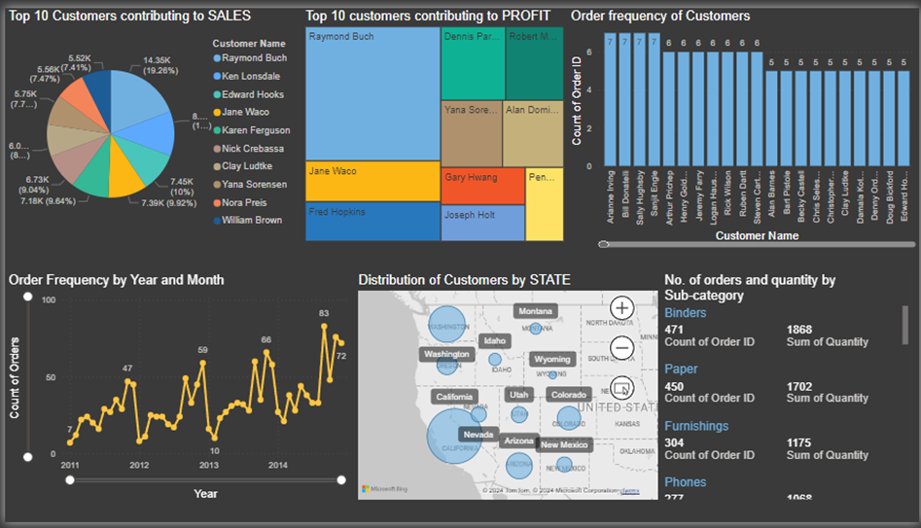
CUSTOMER ANALYSIS DASHBOARD
A customer analysis dashboard is used to analyse customer data, such as demographics and purchase history, to gain insights into their behaviour and preferences.

Slide 14
CUSTOMER ANALYSIS DASHBOARD
FREQUENCY OF ORDERS BY EACH CUSTOMER: The highest frequency is 7 by Arianne Irving, Bill Donatelli, Sally Hughsby and Sanjit Engle. We can say that the customers who ordered 4 and more times are our loyal customers.
Order frequency from line chart :shows order traffic each month or year. We can observe that during last quarters i.e. mostly during November and December there is a high traffic in orders. This is a seasonal trend seen in all years.
The demography of customers can show where our most customers place order. California, Washington and Arizona are the top three states where our customers order products.
A card shows the no. of orders and quantity by product sub-category to see the popular product categories. Binders, paper, furnishings and phones are the top product sub-category
We can select a customer from top 10 list or most ordered customers to see the states he/she has placed order, what’s their order frequency and history, and the product category he/she ordered.

Slide 15
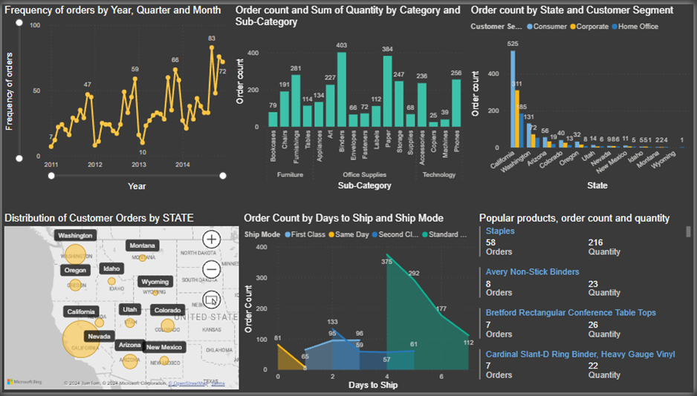
INVENTORY & STORE MANAGEMENT DASHBOARD
To monitor the inventory levels for ensuring supply of popular products, and to optimize the store performance by analysing customer traffic a dashboard is created to visually analyse it.

Slide 16
INVENTORY & STORE MANAGEMENT DASHBOARD
Order frequency from line chart :shows order traffic each month or year. Order traffic is high during fourth quarter so we must be prepared for adequate stock of products. This is a seasonal trend seen in all years.
Column chart displays the no. of orders placed in each sub-category. We can see that the binders and paper in office supplies are the popular product sub-category.
Clustered column chart displays the no. of orders placed in each customer segment by state. We can see that consumer segment is dominant in all states. And most of our orders are from California.
From a simple map we can identity the order traffic from each state to manage/plan the inventory and shipping in that state.
An area chart shows the order traffic in each shipping mode and the days for those orders to get shipped. We can see that most customers opt for standard shipping of 4 to 7 days.
A multi-row card shows the popular products with their order count and quantity.
All the charts are responsive. Once we click drill down and select a data point in line graph, we can see the days where the traffic was high, popular products and their order and quantity, from where the orders are placed, customer segment and product category and the shipping mode.
With this we can be well planned to provide supply of products in all states.

Slide 17
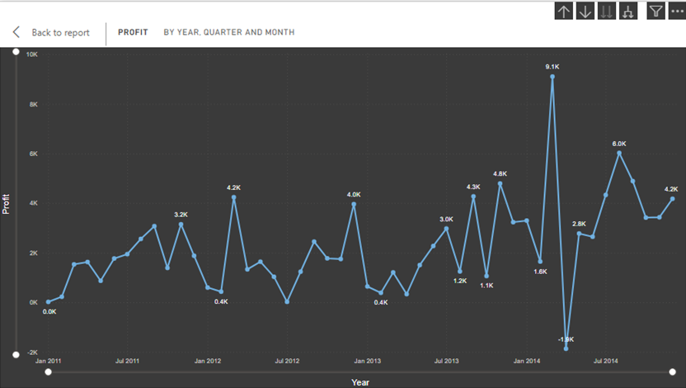
ROOT CAUSE ANALYSIS
The problem statement for root cause analysis is: Loss of $1867.75 on April 2014.
By seeing the profit line chart, we can observe that there is a huge loss of $1867.75 on April 2014.
Normally during September, November and December the sales and profit value is high. But In 2012 and 2014 profit in March is the highest.
Since the profit values of march 2014 and April 2014 are outliers, this might not happen every year. But the profit of last two years 2013 and 2014 shows April as their lowest value.
Hence, it is taken as a problem statement to analyse the factors causing the loss.

Slide 18
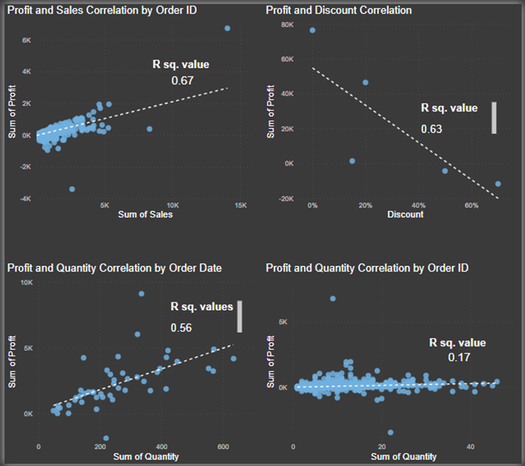
CORRELATION ANALYSIS
By using scatter plots we can see the correlation of profit with various factors like order quantity, sales and discount. Quick measures can be used to calculate the correlation coefficient of the trend line.
When categorised by order ID: profit has a positive correlation with sales. R² is 0.67 which indicates moderate relation between the two variables.
When categorised by order ID: Profit and discount have negative correlation. When discount is high the profit is low or there can be loss. R² is 0.63.
When categorised by order ID, profit has no/very mild correlation (R² =0.17) with Quantity.
But when we categorise the profit and quantity by order date there is a positive correlation R²= 0.56.
So we can conclude that if the order quantity is high profit will increase.
The outliers of april 2014 and march 2014 can be seen in all these scatter plots.

Slide 19
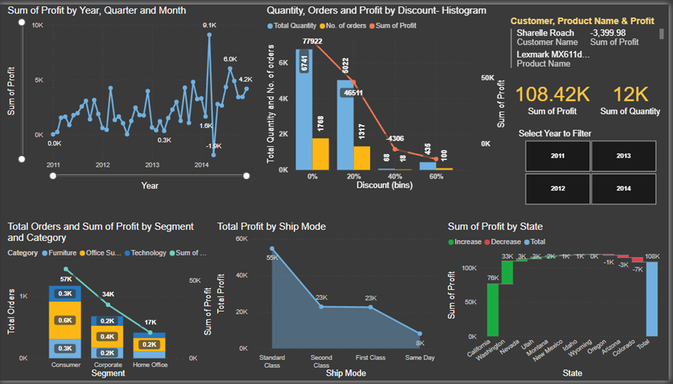
DASHBOARD CREATION

Slide 20
DASHBOARD CREATION
The dashboard consists of:
Line chart – to represent profit by Order date. Can be drilled down from year to days.
Histogram and Line chart- discount bins with bin width of 20% is created to see order quantity and number of orders in each discount bin. A line represents the total profit in each discount bin.
The minimum discount is 0% and maximum is 70%. We have 0%, 15%, 20%, 50% and 70% of discount in our dataset.
A total of four bins will be created with width of 20% (0%-20%, 20%-40%, 40%-60%, 60%-70%). Note that each bin includes the value of the lower limit but not the upper limit. Example the 20% bin consists of quantity, orders, profit for 20% to 39%.
Stacked column and line Chart: To visualize the order count by customer segment ,product category and the total profit from each consumer segment.
Area Chart: To visualize the total profit for each shipping mode.
Waterfall Chart: To visualize the profit from each state adding up to the total profit.

Slide 21
FACTORS CAUSING LOSS
From the dashboard we can gather these insights:
Both the 50% discount and 70% discount data shows loss of $4306 and $11709 respectively. This indicates that most of the products sold with 50% and 70% discount are causing loss.
The huge loss of $11k when the discount is 70% is due to products in binders, bookcase and machines sub-category.
In the waterfall chart green indicates profit and red indicates loss. Colorado, Arizona, Oregon are the states which contributes to loss.

Slide 22
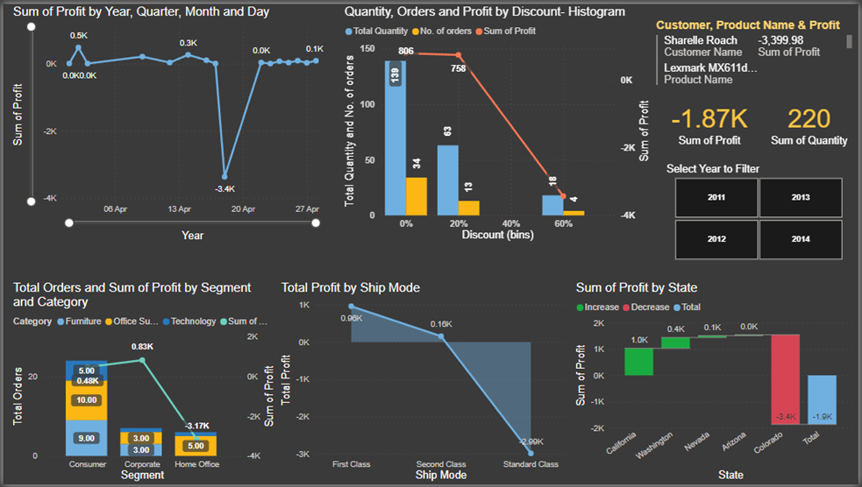
FACTORS CAUSING LOSS
Use the drill down option in line chart and select the value: April 2014 to further know the factors that are leading to this loss.

Slide 23
FACTORS CAUSING LOSS
We can see through-out this month there has been very less profit of maximum 0.5k. But on 18th April the loss is $3364.87. This is the main value leading to the total loss of $1.87k in April 2014
About $3431 of loss is coming from 18 nos. of products from home office segment with 70% discount.
If we select the data point in 60% discount bin we can find the following.
That all these orders of different home office products were made by Sharelle Roach from home office and technology product-category.
The top most product which is contributing to a loss of $3399.98 is Lexmark MX611dhe Monochrome Laser Printer. The order quantity of this product is 5nos.
All these orders were made from the state Colorado with standard ship mode.
Solution:
To reduce loss, we must make a decision to not sell most valued (high priced) products of binders, bookcase and machines with 70% or 50% discounts.
Instead, we can discount these products by 20% or 30% with 5% or 10% extra off on order quantity more than 3.

Slide 24
CONCLUSION
The learning outcomes achieved by completing this project:
1. Data Modelling:
Cleaning the data, analysing the data types and removing symbols and null values.
Creating new column (Days to Ship) to know the time taken to ship orders.
Creating quick measures to calculate correlation coefficient.
Grouping Discount to create Bins for using it in Histogram.
2. Data Visualization and Report Development:
• Creating dashboards with slicers and cards to interact with charts like: Line Chart, Column Chart, Bar Chart, Simple Map, Area Chart, Waterfall Chart, Pie Chart, Donut Chart, Tree Map, Histogram, Stacked Column Chart, Decomposition Tree.
3. Business Solution:
• Doing Root cause analysis to find solution for business problems.
• Analysing sales, profit and customer to find areas of improvement.

Slide 25


